Slide 1

Predicting the Next Hit Song
Alexandra Barker

Slide 2



Premium
Alex
Table of Contents
Featured Artists
Project Description
Table of
Data Wrangling
Contents
EDA
Data Modeling
#
Title
Artist
Confusion Matrix
1
Project Description
SZA
3
Dashboard
2
Data Wrangling
Taylor Swift
4
Conclusion
3
Exploratory Data Analysis
The Weeknd
9
Future Work
4
Statistical Analysis & Predictive Modeling
Sam Smith feat. Kim Petras
13
5
Future Work
Rihanna
17
6
Conclusion
Bebe Rexha
18
7
References
Calvin Harris
19

Slide 3

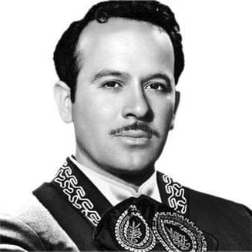




Premium
Alex
Featured Artists
Table of Contents
Featured Artists
Background
Featured Artists
Agenda
Project Description
Data Cleaning
Data Wrangling
EDA
EDA
Alex Barker
Pedro Infante
Selena Gomez
Artist
Artist
Artist
Dashboard
Data Modeling
Data Modeling
Confusion Matrix
Conclusion
Dashboard
Impact
Conclusion
Future Work
Future Work
Alan Walker
Justin Bieber
Billie Eilish
Artist
Artist
Artist

Slide 4
1 Project Description
1.1 Business Context
Over the last couple of decades, with the burst of new and improved technologies, the music industry has been particularly innovative and disruptive. The adoption of streaming music has been one of the most impactful turns in the industry. As a result, the recording industry's business practices as well as how people listen to, share, and enjoy music have already changed. Music streaming accounted for 84% of total U.S. music industry revenues in 2021, according to the Recording Industry Association of America (RIAA). It is projected to reach about $5.46 billion at an annual rate of 6.16%.
There is a wide assumption that artists earn money when their music is played on streaming platforms. However, a number of parties may be owed a percentage of money for each track on a streaming platform, to include the artist, lyricist, producer, instrumentalists, and the record label. Given that so much income and revenue for so many people is tied up in these metrics, it would theoretically be in the interest of the music industry to generate music that is likely to gain higher numbers of streams and therefore generate more revenue. The interaction of listeners with music on these platforms ultimately determines its popularity and how much revenue artists' generate.
With the current easy accessibility to a huge range of music, there is an increasing demand for new and trendy music from artists and record labels. In the current competitive market, understanding what makes an album or song successful is key. Maintaining a continuous knowledge of influencing factors gives a fair idea of how a song may do.
Due to improved technologies in exploratory and predictive analytics, most streaming platforms have value-added services such as predicting success of an album or how popular a single song may be commonly by means of rankings. This study utilizes machine learning models that try to predict the popularity of a song. We also employ exploratory analysis methods to determine which of the variable(s) in the dataset contribute more to how popular a song may be.
1.2 Problem Statement
This study attempts to address the following research questions:
Is popular music formulaic?
Which variable or variables contribute more to whether or not a song will be a success?
Can we develop a successful model to determine the relative contribution of each of the predictors?
1.3 Scope & Limitations
We hypothesize that popular music is formulaic, and successful because of a standardized variety of factors that make the music pleasing to a majority. Music industry stakeholders can use this information to more selectively invest in music that is statistically more likely to garner revenue based on previous performance and music factors.
3

Slide 5
This study is limited by the music selection – data is restricted to one music streaming platform, Spotify (although arguably the platform with one of the most extensive libraries), and does not include every song released during the time period. There are also outlying factors in the amount of money and marketing given to certain songs or artists that may advantage them for “hit” status more than more independently-produced tracks, and certain tracks’ popularity may be related more to social or pop culture factors rather than the aspects of the music we are analyzing. Furthermore, several of the factors taken into consideration are difficult to measure and rely on perception and confidence measures, which may lead to a certain standard of error.
2 Data Wrangling
2.1 Datasets
This project will be conducted utilizing 6 datasets pulled from Spotify’s API using their Audio Analysis capability to measure audio features. Each one of the datasets contains track information from one decade between 1960 and 2019. It measures various aesthetic qualities of each track (e.g., tempo, key, loudness, etc.). This dataset also includes a measure of each track’s popularity based on whether or not the track appeared in any Top 100 list during the decade it was released.
2.2 Data Sourcing
Our datasets were sourced from a Kaggle repository, originally pulled using Spotify’s API for developers, and divided into decades as follows:
60s: 1960-1969
70s: 1970-1979
80s: 1980-1989
90s: 1990-1999
00s: 2000-2009
10s: 2010-2019
The data contained in each dataset consists of the tracks originally released during that particular decade, the audible factors in each track, and the “popularity” of each track (whether or not the track appeared in any Top 100 list in the decade it was originally released). The specific attributes, variables, and criteria of each variable and measurement are elaborated within the data schema below (Table 1).
2.3 Data Profile
Table 1. Data Schema
Field | Type | Description
track | object | The Name of the track
artist | object | The Name of the Artist
uri | object | The unique resource identifier for the track
4

Slide 6
danceability | float64 | Danceability describes how suitable a track is for dancing based on a combination of musical elements including tempo, rhythm stability, beat strength, and overall regularity. A value of 0.0 is least danceable and 1.0 is most danceable.
energy | float64 | Energy is a measure from 0.0 to 1.0 and represents a perceptual measure of intensity and activity. Typically, energetic tracks feel fast, loud, and noisy. For example, death metal has high energy, while a Bach prelude scores low on the scale. Perceptual features contributing to this attribute include dynamic range, perceived loudness, timbre, onset rate, and general entropy.
key | int64 | The key of the song as indicated in pitch class notation {0:C; 1:c#/Db; 2:D; 3:D#/Eb; 4:E; 5:F; 6:F#/Gb; 7:G; 8:G#/Ab; 9:A; 10:A#/Bb; 11:B}. If no key is detected, the value is -1.
loudness | float64 | The overall loudness of a track in decibels (dB). Loudness values are averaged across the entire track and are useful for comparing relative loudness of tracks. Loudness is the quality of a sound that is the primary psychological correlate of physical strength (amplitude). Values typically range between -60 and 0 db.
mode | int64 | Mode indicates the modality (major or minor) of a track, the type of scale from which its melodic content is derived. Major is represented by 1 and minor is 0.
speechiness | float64 | Speechiness detects the presence of spoken words in a track. The more exclusively speech-like the recording (e.g. talk show, audio book, poetry), the closer to 1.0 the attribute value. Values above 0.66 describe tracks that are probably made entirely of spoken words. Values between 0.33 and 0.66 describe tracks that may contain both music and speech, either in sections or layered, including such cases as rap music. Values below 0.33 most likely represent music and other non-speech-like tracks.
acousticness | float64 | A confidence measure from 0.0 to 1.0 of whether the track is acoustic. 1.0 represents high confidence the track is acoustic.
instrumentalness | float64 | Predicts whether a track contains no vocals. “Ooh” and “aah” sounds are treated as instrumental in this context. Rap or spoken word tracks are clearly “vocal”. The closer the instrumentalness value is to 1.0, the greater likelihood the track contains no vocal content. Values above 0.5 are intended to represent instrumental tracks, but confidence is higher as the value approaches 1.0.
liveness | float64 | Detects the presence of an audience in the recording. Higher liveness values represent an increased probability that the track was performed live. A value above 0.8 provides strong likelihood that the track is live.
valence | float64 | A measure from 0.0 to 1.0 describing the musical positiveness conveyed by a track. Tracks with high valence sound more positive (e.g. happy, cheerful, euphoric), while tracks with low valence sound more negative (e.g. sad, depressed, angry).
5

Slide 7
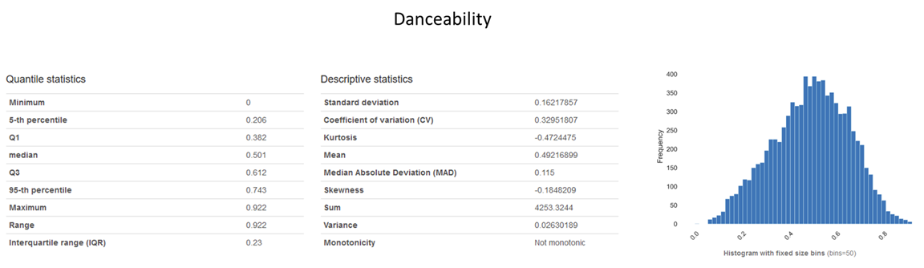
tempo | float64 | The overall estimated tempo of a track in beats per minute (BPM). In musical terminology, tempo is the speed or pace of a given piece and derives directly from the average beat duration.
duration_ms | int64 | The duration of the track in milliseconds.
time_signature | int64 | An estimated overall time signature of a track. The time signature (meter) is a notational convention to specify how many beats are in each bar (or measure).
chorus_hit | float64 | This is the author's best estimate of when the chorus would start for the track. It's the timestamp of the start of the third section of the track (in milliseconds). This feature was extracted from the data received by the API call for Audio Analysis of that particular track.
sections | int64 | The number of sections the particular track has. This feature was extracted from the data received by the API call for Audio Analysis of that particular track.
target | int64 | The target variable for the track. It can be either '0' or '1'. '1' indicates that this song has featured in the weekly list (Issued by Billboards) of Hot-100 tracks in that decade at least once and is therefore a 'hit'. '0' indicates that the track is a 'flop'.
2.4 Data Cleaning
We checked the data types of each variable in each dataset and found that the data types were consistent across all datasets.
These data types were consistent with the most useful presentation of what each variable is measuring. In the variables that are indicators of a certain measurement on a scale from 0.0 to 1.0, for example, those variables are returned as floats. Furthermore, in simpler positive or negative indicators (reflected as a 0 if the criteria is not met and a 1 if it is), those data types are returned as integers. Other data types such as strings are returned as objects.
We performed analysis on each variable within each dataset to observe the minimum, maximum, mean, standard deviation, one-dimensional distribution, occurrence of zero or null values, and percentage of distinct values to compare those observations with our awareness of what we should expect within these datasets (Figure 1 & 2).
6

Slide 8
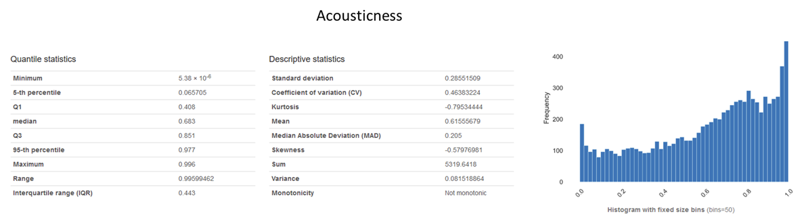
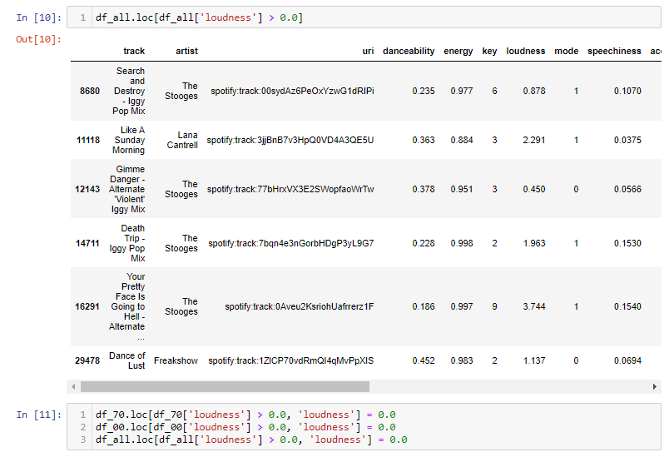
Figure 1 & 2. Example of feature observation performed for each variable.
There were no blank or null values in the datasets. There are zero values present, but upon investigation we determined that the majority of these zero values are valid and within the acceptable parameters for the variable ranges.
Some outliers that needed to be addressed:
Some loudness variables were greater than zero (loudness is measured on a scale of -60 to 0, so no value should exceed 0). This seems to be an error in the audio analysis used by the Spotify API to assign values to qualitative variables.
We adjusted these values to the maximum value of 0.0.
Some values (danceability, tempo, sections, chorus_hit) were equal to zero when this is very unlikely. In most instances of these values, particularly for the sections and chorus_hit variables, it was due to the track being very short (usually less than 15 seconds) with no discernable, distinct sections.
7

Slide 9
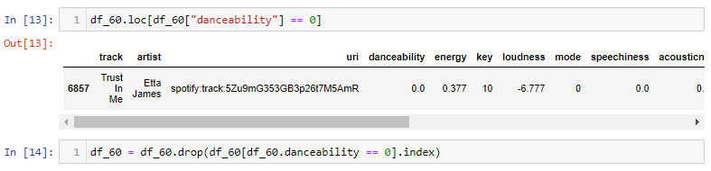
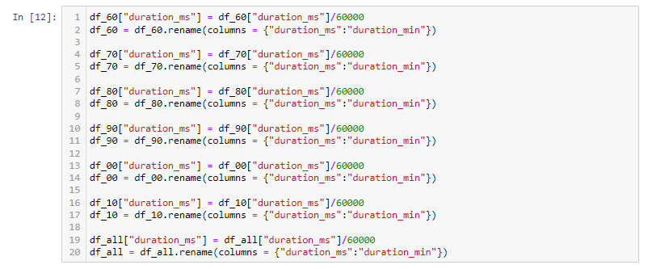
In one instance, one particular track by Etta James in the 60s dataset had many variables with zero values erroneously. We decided that it would be in the best interest of the study to drop this particular track to avoid any negative impact to the analysis.
Some acousticness measures were very low (e.g., one acousticness measure in the 60s dataset is about 5.38e-6), which, while possible, is cause for deeper investigation.
After further observation, there didn’t seem to be any cause for concern here, we determined that the values were within the acceptable range.
Some duplicate values were found within the track and URI columns. Some duplicate URIs are due to two variations of the same song (example, I Don’t Care (feat. Adam Gontier) by Apocolyptica and I Don’t Care by Apocolyptica featuring Adam Gontier), but others are seemingly completely different songs (example, Want To and All I Want to Do, both by Sugarland) by the same artist that seem to share a common keyword but are not the same song. We observed that some of these duplicate URIs share audible characteristic measurements despite being audibly different, however, they did occasionally vary in the target measurement.
The group decided to allow these tracks to remain within the dataset since the URI values will have no impact on numerical analysis.
We also wanted to address outliers in duration, while the majority of the tracks were under 5 minutes, some extreme examples (up to 70 minutes in some datasets) significantly impacted duration aggregates. We considered removing tracks outside a certain duration threshold, but felt it would not be thorough to not consider such tracks in our analysis and didn’t see any benefit of removing them.
We converted the duration variable from milliseconds to minutes (float) to make the measurement more easily understandable and readable at a glance (for example, 1 minute 15 seconds would be represented as 1.25 minutes), since music is traditionally measured in minutes and seconds.
8

Slide 10
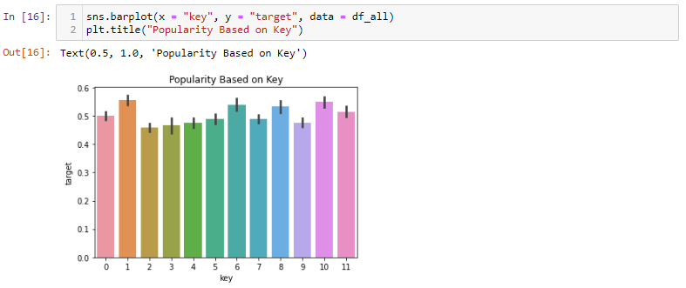
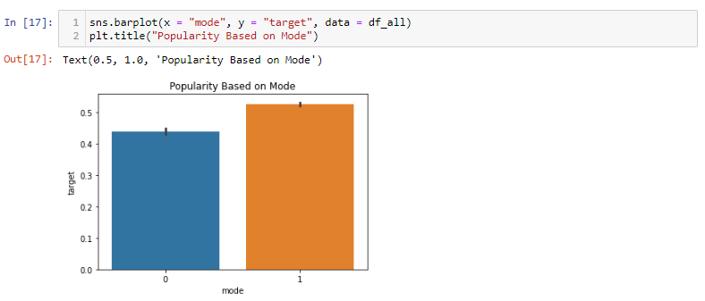
The last thing we wanted to do was to create a new cumulative dataset by merging all decade datasets into one. We added a column to each dataset (called “decade”) to identify which original dataset and decade each track belonged to, then merged into a cumulative dataset called “dataset-alldecades.csv”. The purpose of this is continued ease of analysis for trends that may or may not transcend decades.
3 Exploratory Data Analysis
3.1 Feature Visualization
We created some feature visualizations to get an idea of what each of the features look like. Some examples are below.
Figure 3. Visualization of Popularity by Key
Figure 4. Visualization of Popularity by Mode
9

Slide 11
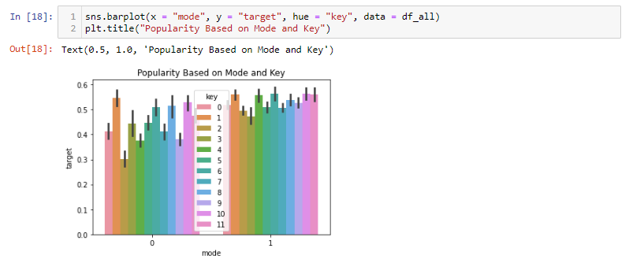
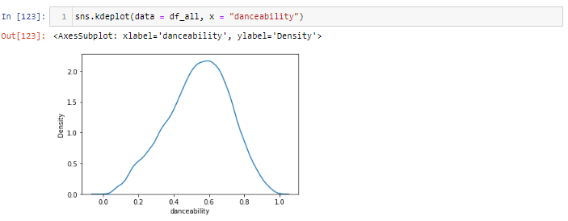
Figure 5. Visualization of Popularity by Mode and Key
Figure 6. Density Plot of danceability
3.2 Correlation Analysis
We created Seaborn Pairplots for each dataset to further attempt to identify potential trends. Overall, no trends become apparent. The closest relationship we can visually observe seems to be between loudness and energy.
10

Slide 12
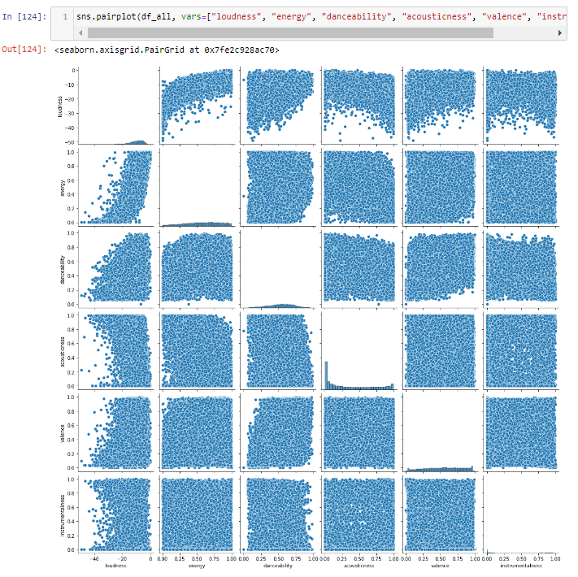
Figure 7. Seaborn Pairplot of loudness, energy, danceability, valence, and instrumentalness
We also wanted to visualize this information in the form of a heatmap.
11

Slide 13
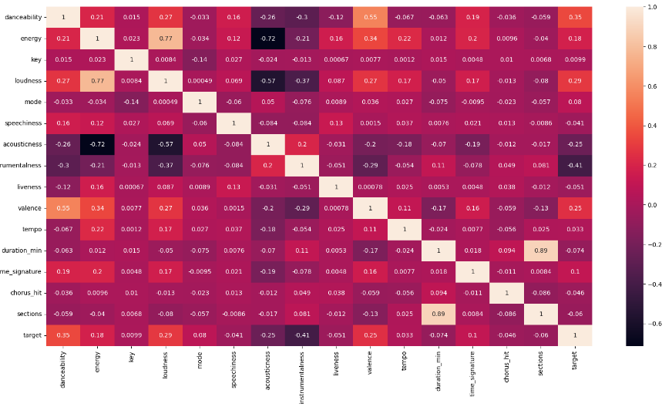
Figure 8. Correlations between all the variables in the form of a heatmap
Notably strong correlations (> 0.7) between variables occur between loudness and energy (0.772), and sections and duration_min (0.889). This makes sense because typically as the loudness of a song increases, so does its perceived energy level. Sections and duration_min are also not surprising since the longer a track is, it will likely contain more sections.
Weaker but still above average correlation occurs between valence and danceability (0.554).
In the comparison between the variables and the target variable, the “strongest” are valence (0.251), loudness (0.286), danceability (0.346), and energy (0.177), although these correlations are well below the 0.7 threshold and are considered weak correlations.
There is a strongly-correlated inverse relationship between energy and acousticness. This also makes sense because the higher the probability of a song being acoustic, the more likely it is to be perceived as low-energy.
Point Biserial
We used the Point Biserial method of correlation analysis due to the bivariate nature of the target variable. Point biserial is frequently used when one variable is dichotomous. We analyzed the correlation coefficients and p-values between the audio factors with the highest correlation according to the heatmap (we also analyzed the other audio factors but found the correlations were below 0.1 or negative, consistent with the heatmap analysis).
12

Slide 14
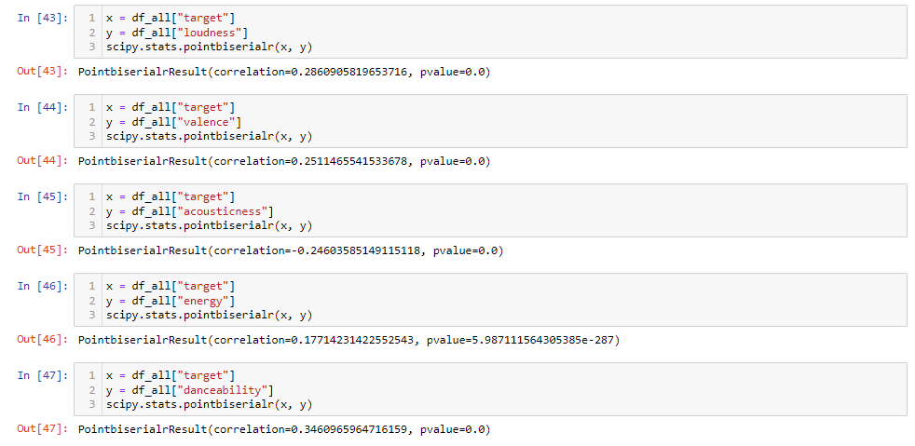
Figure 9. Points Biserial for each feature.
In all the methods used, the correlation coefficients overall are very low. Generally lower than 0.34, indicating a very weak correlation between these variables and the target variable.
The p-values are close to zero (below 0.05 threshold on all and all very close to zero), so we can determine that although the correlation is low, it is statistically significant.
At the moment, the strongest correlation coefficient is danceability at 0.346. Our R-Squared, our coefficient of determination threshold, is 0.12.
Overall, none of our individual variables are strongly correlated, meaning there is no single audible factor that will strongly indicate whether a track will be popular or not. We hypothesize that the strongest correlation is some combination of factors, which will involve more advanced statistical modeling to discover.
4 Statistical Analysis & Predictive Modeling
4.1 Classification Models
Our more advanced models will need to combine features to produce an accurate model, but without overfitting. Machine Learning methods are useful for building these predictive models. With the output we are aiming for, Supervised Machine Learning models are the best fit because they build a model to estimate and predict outcomes based on one or more inputs. Because our target variable is bivariate with discrete values as opposed to continuous, we will need to use Classification Models. Classification Models deal with categorical outputs (ex: A or B) as opposed to Regression Models which deal with continuous outputs (ex: any number on a scale of 0 to 100).
13

Slide 15
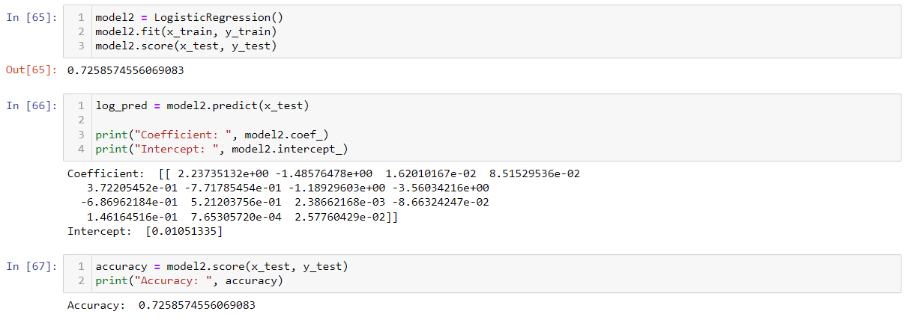
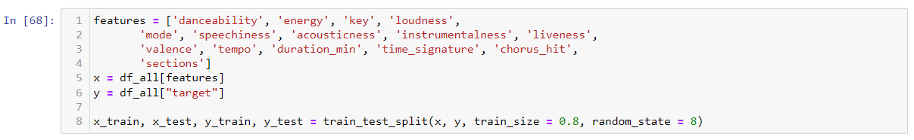
In Classification Models, we are using the Scikit-Learn library’s accuracy_score() function to gauge the model’s accuracy. This function measures the number of correct predictions in a model divided by the number of total predictions to return a decimal representation of a percentage. We have made our goal to create a model with an accuracy score greater than 75% or 0.75.
4.2 Train-Test Split
Through each of these models, we utilized a training and testing split. This technique divides the dataset into a Training Set and a Testing Set. It trains the model on the training set, then tests the accuracy of the model on the testing set to measure the model’s performance and simulate how the model would work on new data.
We split the data into a training set and a testing set. Using the audio factors as independent variables (x) and the target variable as the dependent variable (y), we used the “standard” train:test split of 80:20 (argument train_size = 0.8), and a random_state variable of 8 to fit the model.
Figure 10. Example of the code for the train-test split
4.3 Model 1: Logistic Regression
Logistic regression is an algorithm used when the dependent variable is binary, like our target variable. In this situation, binomial logistic regression is useful to predict a classification problem with only two classes. Our data wasn’t suited to a linear regression function, so we wanted to utilize the sigmoid curve of logistic regression to help us predict classification.
Figure 11. Logistic Regression modeling
This gives us an accuracy rate of 0.726, which is a relatively well-fitting model, but it doesn’t exceed our 0.75 goal.
14

Slide 16
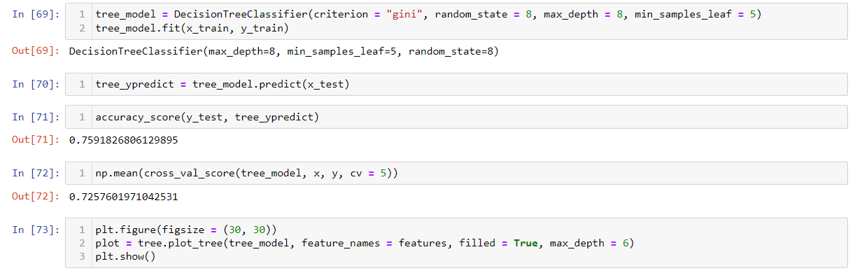
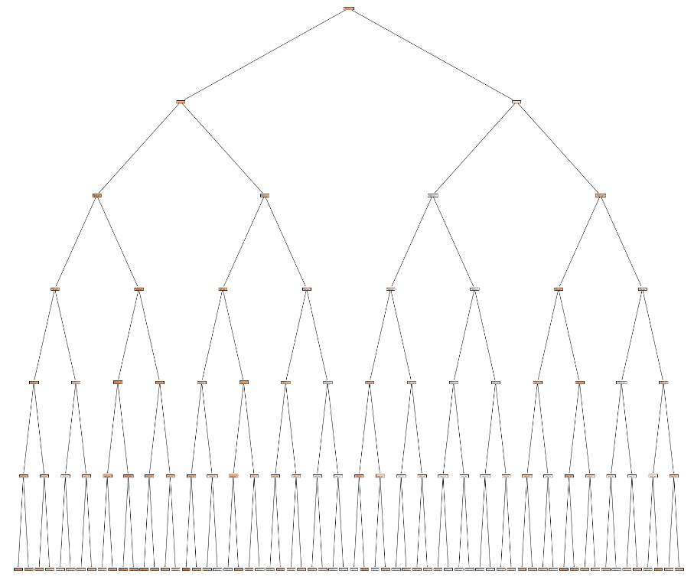
4.4 Model 2: Decision Tree
A decision tree is an algorithm that creates a tree-like model of decisions that calculates a strategy towards a particular goal.
A tree is made of 3 components: a root node, decision nodes, and leaf nodes. Starting from the root, the tree separates into branches of smaller “decisions” until it reaches a stopping point, a leaf node. It uses a training set to find the most accurate “path” through the tree.
We decided to use a decision tree due to the high number of parameters affecting the target variable and the overall non-linear pattern of relationships between parameters and the target variable. Overall, Decision Trees are relatively easy to visualize, and we wanted to be able to easily determine how the model was making decisions.
Figure 12. Example of Decision Tree model
Figure 13: Visualization of the Decision Tree
With an accuracy rate of 0.759, this model exceeds our goal threshold for wellness of fit.
15

Slide 17
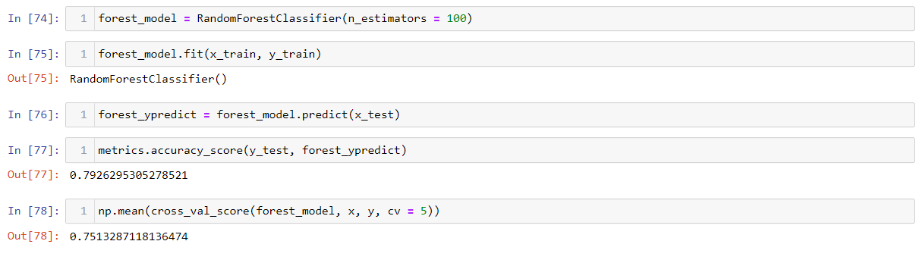
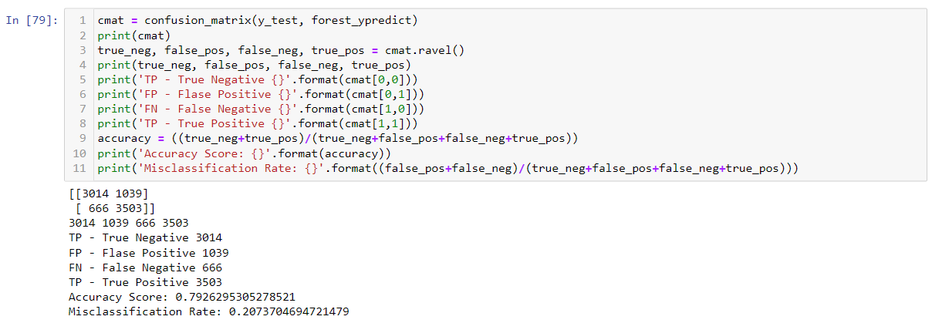
4.5 Model 3: Random Forest
Although our Decision Tree met our threshold of success, we decided to use a Random Forest because it has a few advantages that Decision Trees don’t have. They’re constructed by taking the mean of several decision trees, therefore, random forests are less prone to outliers and less likely to overfit than single Decision Trees. Because we needed to combine many classifiers to look for complex solutions, increasing the number of decision trees used increases the precision of the outcome.
Figure 14. Example of the Random Forest Model
With an accuracy rate of 0.793, and a cross_val_score of 0.751, this exceeds the Decision Tree model metrics and is our most accurate model.
4.6 Confusion Matrix
Figure 15. Example of the input and output of the confusion matrix
The confusion matrix is a performance measurement for machine learning classifications. It helps us measure the effectiveness of our model by running the data through the model, then classifying the results into four categories: True Positive, True Negative, False Positive, and False Negative. The True Positive and True Negative classifications indicate when the model predicted accurately and the False Positive and False Negative indicate when the model
16

Slide 18
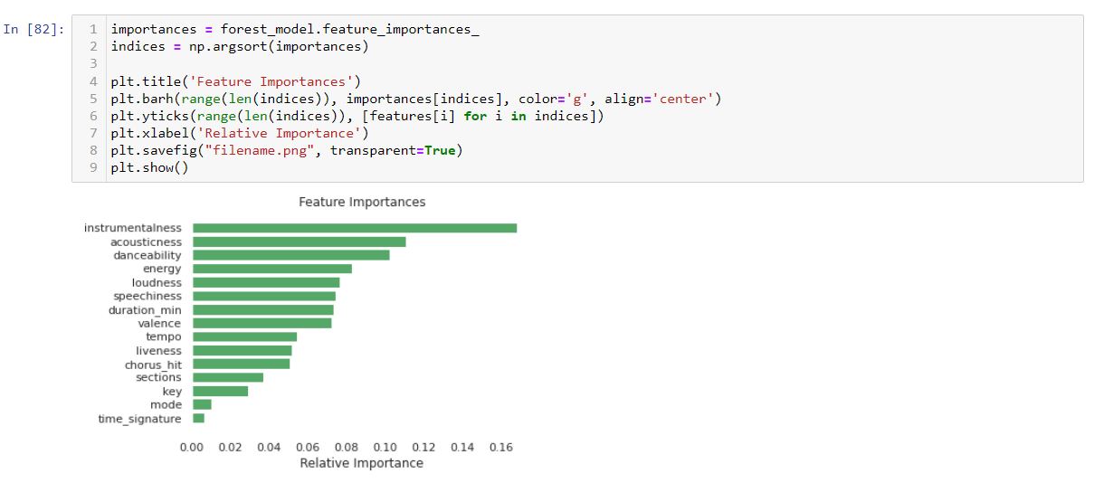
misclassified.
With an accuracy score of 0.793 and a misclassification rate of 0.207, we are correctly predicting the class of observations 58.6% of the time.
Based on our most successful model, we then isolated and ranked the features by importance.
Figure 16. Visualization of features by importance
Based on Figure, we can see that the most important features are instrumentalness, acousticness, danceability, energy, and loudness.
5 Future Work
Using this information, it may help artists and record labels produce more popular “hit”
music and therefore increase the number of streams and revenue. However, other factors that may contribute to a track’s success are more difficult to measure, such as:
Social Media Presence and Following
Marketing Expenditures
Record Label
Previous Artist Success
Artist Networking Value
Additionally, individual music tastes are very different. If music becomes formulaic for the sake of increased revenue, music diversity, creativity, and artistry may decrease.
Potential future analysis could continue to add context and nuance to this complex scenario. We could pull in additional datasets around external factors such as the amount of marketing given to certain artists or albums. We could transform the target variable to a continuous variable, for example the highest ranking the track achieved on the Top 100 billboards.
17

Slide 19
6 Conclusion
Overall, the modeling was successful. We surpassed our target threshold of 0.75 accuracy rate utilizing the Random Forest model with an accuracy rate of 0.793, and a misclassification rate of 0.207 for a correct prediction rate of 58.6%.
Based on this model the most important features for predicting the popularity of a track were instrumentalness, acousticness, danceability, energy, and loudness.
01
Instrumentalness
04
Energy
02
Acousticness
05
Loudness
03
Danceability
06
Speechiness
18

Slide 20
7 References
Friedlander, Joshua. YEAR-END 2021 RIAA REVENUE STATISTICS.
‌“Supervised Machine Learning Algorithms | 2 Types of Learning Algorithm.” EDUCBA, 30 Dec. 2019, www.educba.com/supervised-machine-learning-algorithms/.
“Supervised Learning: Predicting an Output Variable from High-Dimensional Observations.” Scikit-Learn, scikit-learn.org/stable/tutorial/statistical_inference/supervised_learning.html. Accessed 11 Feb. 2023.
“Data Curation 101 | Meaning, Process, Steps & Importance.” Atlan, atlan.com/data-curation-101/.
‌“Statistics Knowledge Portal.” Www.jmp.com, www.jmp.com/en_us/statistics-knowledge-portal.html.
“How to Do Train Test Split Using Sklearn in Python.” GeeksforGeeks, 25 June 2022, www.geeksforgeeks.org/how-to-do-train-test-split-using-sklearn-in-python/.
Narkhede, Sarang. “Understanding Confusion Matrix.” Medium, Towards Data Science, 9 May 2018, towardsdatascience.com/understanding-confusion-matrix-a9ad42dcfd62.
19

